Slide 1
The Agile Team (The A-Team) (TAT)
Project Proposal
Christina
Jason
Steve

Slide 2
Outline
Introduction
Background & Problem
Literature Search
Approach
Management
Resource Allocation
Schedule

Slide 3
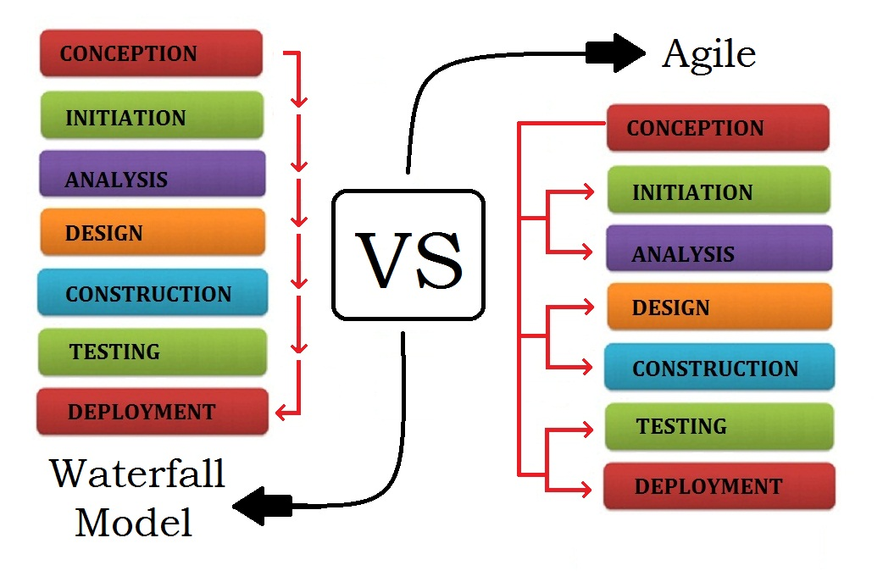
Introduction- Recap of the Problem Definition
Are there benefits from using Agile Software Development methodologies versus Waterfall and Spiral?
Compare Agile with traditional Systems Engineering in terms of:
Cost
Schedule
Quality
http://www.sdlc.ws/agile-vs-waterfall/

Slide 4
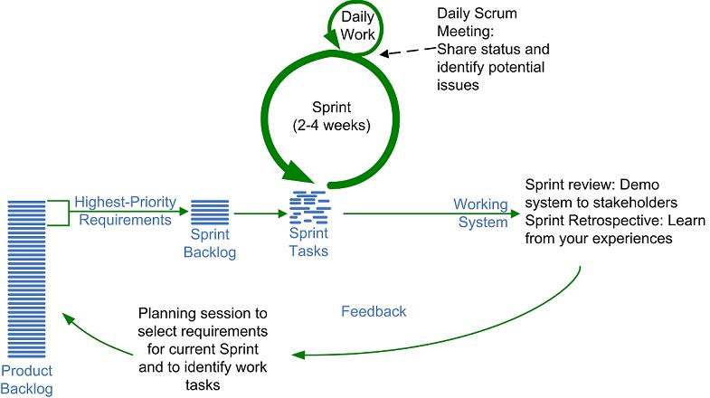
Introduction- Background Agile Development Process
Excerpt from Manifesto for Agile Software Development
-Individuals and interactions over processes and tools -Working software over comprehensive documentation -Customer collaboration over contract negotiation -Responding to change over following a plan
https://www.ibm.com/developerworks/community/blogs/ambler/?sortby=3&maxresults=15&lang=en
STEP-WISE DEVELOPMENT SCHEME
First Step - develop in small steps
Second Step - produce something useful in each step that can be presented to the customer
Third Step - consider Customer feedback in the following development steps

Slide 5
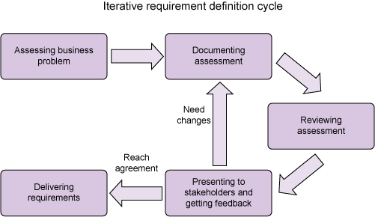
Introduction- Background Agile Development Process
Identify the high level scope
Identify initial requirement stack
Identify an architectural vision
Modeling is part of iteration plan effort
Need to model enough to give good estimates
Need to plan the work for the iteration
Develop working software via test first approach
Details captured in the form of executable specifications
http://www.ibm.com/developerworks/rational/library/09/supportagiledevelopmentbyusingibmrationalrequirementscomposer/

Slide 6
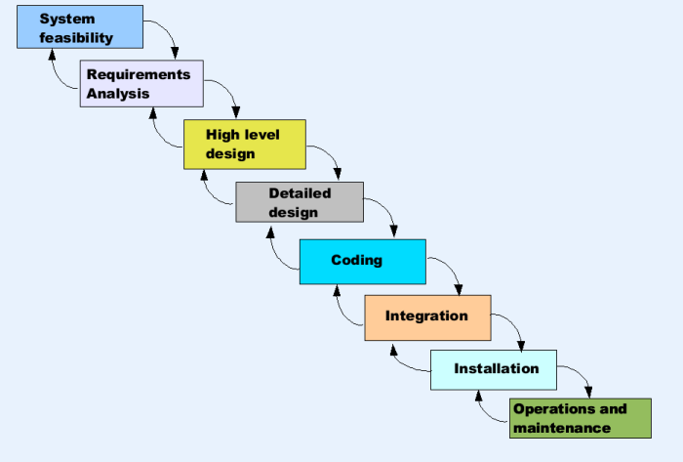
Introduction- Background Waterfall Development Cycle
Initial development model for software systems development
All requirements are known up-front
Form follows function philosophy: “What to do? “ before “How to do it?”
Still used for certain types of systems: - systems with low complexity, and systems that cannot evolve
Relationships between the early phases of the project to the end results are not illustrated
Stakeholder involvement is not recognized beyond the initial requirements
http://programmers.stackexchange.com/questions/11512/are-there-any-major-alternatives-to-waterfall-and-agile

Slide 7
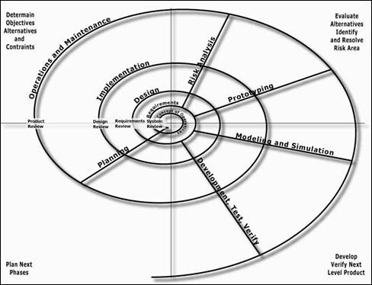
Introduction- Background Spiral Development Cycle
The goal of the model is mitigation of software development risk
Emphasizes the need to iterate between form and function experimentally
Popular in software development – It works easily with emerging properties and partial solutions of software, such as user interfaces, algorithms, or alternative sequences of events. The “I Know It When I See It” approach
The spiral principle is an evolutionary approach to systems development, as illustrated in the V- Development strategies
This model can be used within the phases of the V-Development Model to examine the feasibility of a concept and to derive a set of requirements
Minimizes the idea of defining the goals up front. It encourages never-ending cycles of development
http://programmers.stackexchange.com/questions/11512/are-there-any-major-alternatives-to-waterfall-and-agile

Slide 8
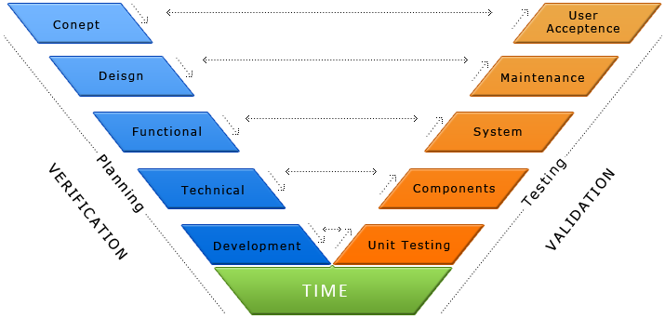
Introduction- Background V- Development Cycle
Illustrates the influence of the early phases of the project on the end of the project
Emphasizes the planning, stakeholder involvement, validation of the requirements, as well as the validation of the product
Illustrates planning, defining, performing integration, and verification. Emphasizes the need to begin verification planning at the time requirements are first defined at every level.
Encourages the “Starting at the Finish Line” mindset, by looking at the validation of the product at the same time as developing the Concept of Operation, as well as the development of Verification Plans with the requirements at every level
Illustrates “top down” definition and decomposition. A specification is written for it to be built as a key systems engineering activity. It shows a “bottoms up” building, integration and verification
http://www.softobiz.com/v-model

Slide 9
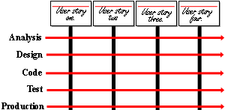
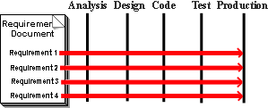
Introduction- Background Key difference between Agile vs Traditional process
Traditional Process
vs
Agile Process
Requirement change = desaster!!!
With a traditional process schedule of activities one after another until the project end date. Design always starts when analysis is finished. Coding starts when the design is done, etc. We make a plan to get everything finished on time. At the end of the schedule the new software is demonstrated and seen if the customer liked it.
Requirement -> System Design
Requirements can change!!!
Each feature of the software is presented as a story to the customer
Story cards are a low cost mechanism for scoping out a project without spending our entire analysis budget up front
User story -> System Design

Slide 10
Literature Search
Focused on three main areas:
1. Existing methods for measuring cost, schedule, and quality for Agile projects.
2. Mapping of Agile methods into traditional development methods.
3. Difficulties in application of Agile for systems developed with traditional methods.

Slide 11
Measuring Cost, Schedule, and Quality
Cost – Pre-existing methods for calculating cost savings for Agile projects.
AgileEVM (earned value managment)
Schedule – Pre-existing methods for graphical representation of schedule for Agile projects
Burn-Up Chart (how much of the project is done at each iteration)
Burn-Down Chart (how much of the project is left to be done at each iteration)
These can be adapted and analyzed against schedule data in a traditional model for any schedule savings
Quality – Very few pre-existing methods and many cannot be applied directly
Mostly are not purely mathematical
Quality is measured in terms of how the process is integrated with the final business goals of the project.

Slide 12
Mapping Agile Methods to Traditional Methods
Where should Agile methods fall on a traditional development cycle?
This method of mapping from one method to another can help us get a better understanding of where similarities and differences lie in how a project is developed using each method.
Most of the research is academic in nature
The research can be adapted to one of the customer’s existing projects that used a traditional development cycle to mock up a trade study for the same project using Agile.

Slide 13
Difficulties in Applying Agile Development
Current research discovers that there are pros and cons in applying Agile for project development.
Often, the method is difficult to map in certain situations.
Large scale systems; Agile does not scale well
Companies with rigid management procedures
The need to define requirements upfront to limit scope-creep is not within Agile’s methodology.
Given the problems of applying Agile, it may be difficult to develop measuring methods for finding cost, schedule, or quality using Agile on a project originally developed using a traditional method.

Slide 14
Approach: Overview
Use a phased approach to compare Agile to traditional Systems Engineering software development methodologies
The four phases are:
Research and Information Gathering
Development of Evaluation Metrics
Analysis of Data
Presentation of Results

Slide 15
Approach: Research and Information Gathering
Academic Centric
Sponsor Centric
Capacious, high-level information
Systems Engineering in general
Broad in Scope
Challenging to collect specific information
Focused, specific information
Systems Engineering within Boeing
Narrow in Scope
Challenging to collect over-arching information

Slide 16
Approach: Research and Information Gathering – Key Challenge
Finding appropriate projects to compare
Not typical for a project to be performed more than once by the same company using fundamentally different methodologies.
Every company is different, every project is different, every companies application of Systems Engineering models is different

Slide 17
Approach: Development of Evaluation Metrics
Compare Agile with traditional Systems Engineering in terms of:
Cost
Schedule
Quality
Quantifiable results are more valuable than indeterminate results

Slide 18
Approach: Development of Evaluation Metrics
How do we define an improvement?
Cost: Could the same result be achieved for a lower price?
Schedule: Could the same result be achieved with a smaller investment of total hours?
Quality: Sponsor’s thoughts will guide determination of a quality improvement.
BeautyQuality is in the eye of the bestakeholder.

Slide 19
Approach: Analysis of Data
Can we just plug and chug? Ideally yes, realistically no.
Sensitivity Analysis – what is the robustness of our result, given uncertainty
Care must be taken to insure the scope of results is within the scope of the data

Slide 20
Approach: Presentation of Results
An objective is to have persuasive results
In particular, special care must be taken to clearly demonstrate how the evaluation metrics were derived.
We want definitive results, supported by a robust analysis.

Slide 21
Approach Summary
Research and Information Gathering
Data suitable for analysis
Development of Evaluation Metrics
Involve Sponsor to support Metrics
Analysis of Data
What the data really says
Presentation of Results
Clear, Robust, Concise, Persuasive
Four Phases working towards development of a robust result.

Slide 22
Milestone Schedule
2/4 Presentations, Problem Definition
2/18 Proposal Team Presentation
2/25 Written Proposal
3/4 Finalized Scope Definition/Stakeholder Buy-in
3/11 Spring Break –partay Website Up and Running
Sponsor Centric Data Collection Completed
3/18 In Progress Review Presentation
3/25 Evaluation Metrics Determination Kick-off
Sponsor Input on Metrics (Value Elicitation)
4/1 Individual Team Meeting w/ instructor Status and draft of final presentation
4/8 Individual Team Meeting w/ instructor Status and draft of final presentation
4/15 Data Analysis Completed
4/22 Start Compiling Final Report
4/26 Final Report Completed
4/29 Dry run of final presentation
5/6 Dry run of final presentation Final report due
5/10 Final presentation to Faculty

